Slide 1

Predicting Used Car Prices
– Tushar Dupare

Slide 2
1. Data Exploration
2. Data Preprocessing
3. Data Cleaning
4. Data Visualization
Project Agenda
5. Feature Engineering
6. Model Building
7. Model Evaluation
8. Predicting Result

Slide 3
Project Overview
The used car market is vast and highly variable in terms of pricing. Both buyers and sellers need a reliable system to estimate the value of a used car based on various factors like age, mileage, model, and more. Predicting the price accurately can help both parties make informed decisions.
The objective of this project is to build a predictive model for car prices using a dataset of used cars. The project involves conducting comprehensive exploratory data analysis (EDA) to understand the relationships between various features and car prices, preprocessing the data to handle missing values and encode categorical variables, engineering new features, and evaluating the performance of different regression models. The ultimate goal is to create an accurate and reliable model that can predict the price of a used car based on its attributes, and to effectively communicate the findings and insights through clear and informative visualizations.
Objective

Slide 4
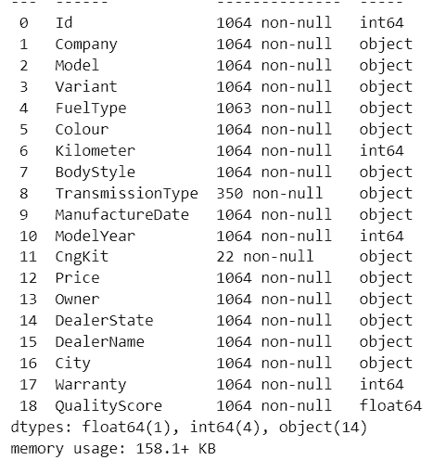
Understanding Data
Information about columns of the dataset :
ID
COMPANY
MODEL
VARIANT
FUEL TYPE
COLOUR
KILOMETER
BODYSTYLE
TRANSMISSION TYPE
MANUFACTURE DATE
MODEL YEAR
CNG KIT
PRICE
OWNER
DEALER STATE
DEALER NAME
CITY
WARRANTY
QUALITY SCORE
Shape of Dataset:( 1064, 19)
Columns: 19

Slide 5
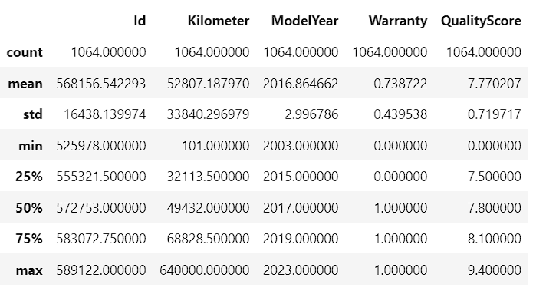
Data Exploration
:
The dataset contains 1064 rows.
The columns Id, Kilometer, ModelYear, Warranty, and QualityScore are numerical.
The remaining columns appear to contain categorical data, such as the car's company, model, variant, fuel type, color, body style, transmission type, owner, dealer state, dealer name, and city.
The column CngKit has a large number of null values (978 out of 1064), suggesting that CNG kits are not common in the data.
The column TransmissionType also has a large number of null values (714 out of 1064), suggesting that transmission type information is not available for many cars.
The column Price is of type object, which means it may contain non-numeric values (e.g., strings). Further analysis would be needed to determine the exact format of the price data.
Kilometer: The average mileage is around 568,156.54 km, with a standard deviation of 16,438.14 km. This indicates a wide range of mileages among the vehicles.
ModelYear: The average manufacturing year is 2016.86, with a range from 2003 to 2023.
Warranty: The warranty status is mostly binary (0 or 1), suggesting it's likely a boolean indicator.
QualityScore: The average quality score is 7.77, with a standard deviation of 0.72. This indicates a relatively consistent quality rating among the vehicles.

Slide 6
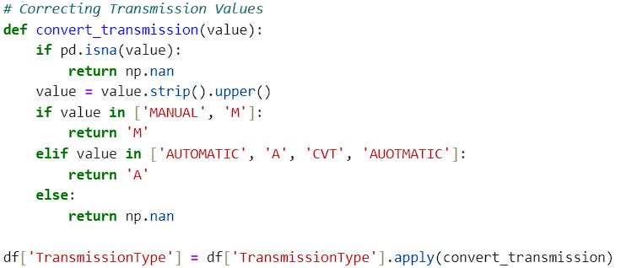
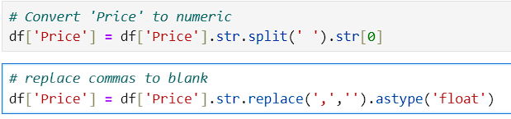
Data Cleaning
Missing Values:
There are missing values in the “Transmission Type“ and ‘’Cng- Kit’’ column 714 and 1042 respectively, which account for only 0.67% and 0.97 % respectively of the values which is lot of data missing.
Rows with missing values in the “Fuel Type" column (1 value) it can be dropped.
Duplicates:
Total duplicates found: 0.
Cleaning of Columns:
Convert Price Column into numerical from categorical
column
Removed Trailing spaces and brackets from BodyStyle
and Model Column
Transmission Column has various name of same value
that has to be treated

Slide 7
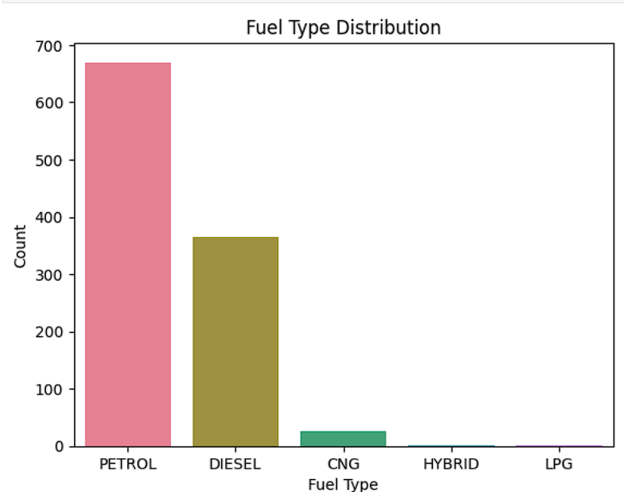
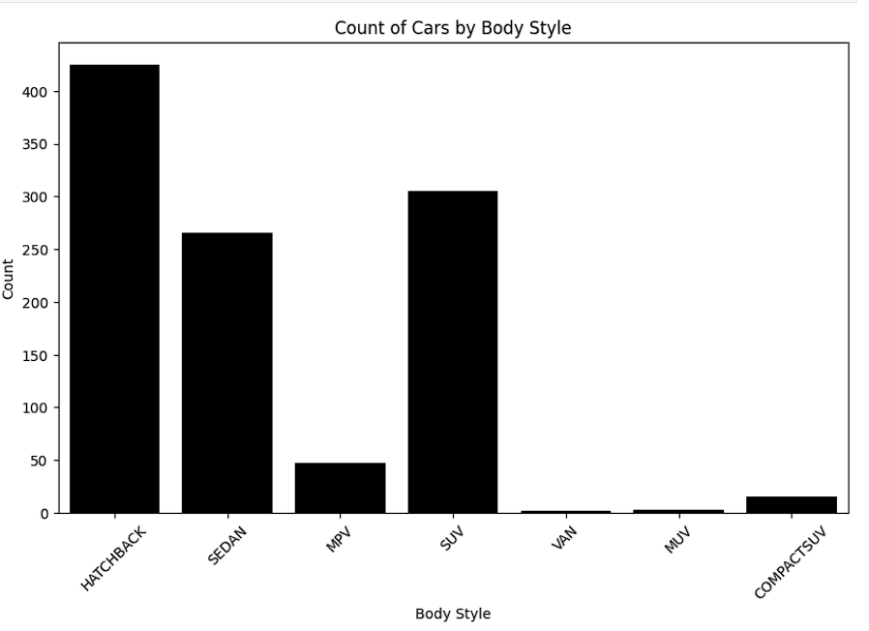
Data Visualization
Dominance of Petrol: Petrol is the most popular fuel type, with a significantly higher count compared to the others.
Diesel: Diesel is the second most popular fuel type, although with a considerably lower count than petrol.
CNG, Hybrid, LPG: These fuel types have relatively low counts, indicating that they are less common in the dataset.
Hatchback Dominance: Hatchbacks are the most popular body style, with a significantly higher count compared to the others.
Sedan Popularity: Sedans are the second most popular body style, although with a considerably lower count than hatchbacks.
SUV and MPV: SUVs and MPVs have a moderate number of cars, indicating that they are fairly popular but not as much as hatchbacks or sedans.
Van, MUV, CompactSUV: These body styles have relatively low counts, suggesting that they are less common in the dataset.

Slide 8
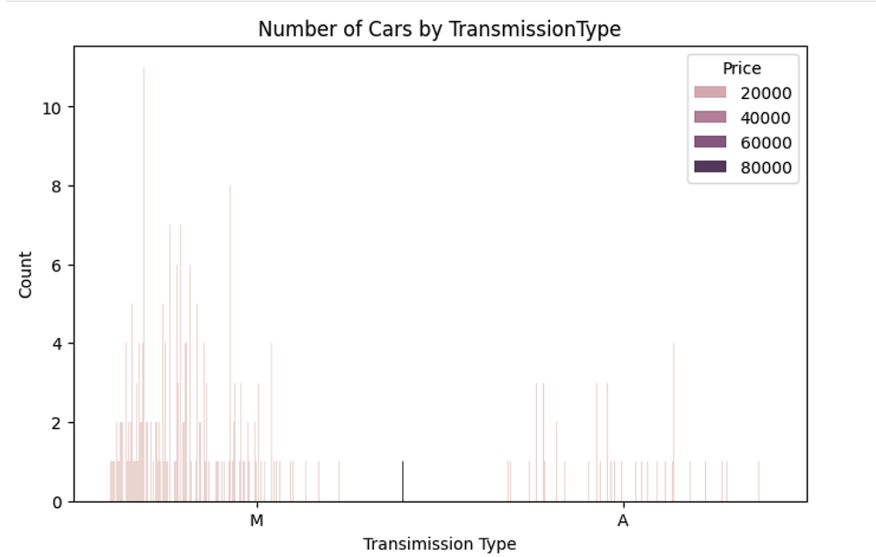
Exploring Transmission Type Data
More cars have automatic transmission than manual transmission. This is evident from the taller bars corresponding to the "A" category on the x-axis.
The price range of cars with automatic transmission is wider than that of cars with manual transmission. This can be seen from the greater variation in the colors of the bars for the "A" category compared to the "M" category.
There is a higher concentration of cars with manual transmission in the lower price range. The bars corresponding to the lower prices for the "M" category are taller than those for the "A" category in the same price range.
There is a higher concentration of cars with automatic transmission in the higher price range. The bars corresponding to the higher prices for the "A" category are taller than those for the "M" category in the same price range

Slide 9
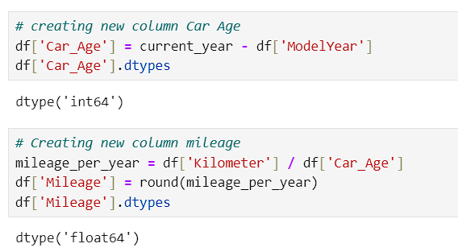
Feature Engineering
1. Car Age:
Calculates the age of each car by subtracting the ModelYear from the current year.
The data type of this column is int64, indicating it contains integer values representing the car's age.
2. Mileage:
Calculates the average annual mileage of each car by dividing the Kilometer by the Car_Age.
The result is rounded to the nearest integer using the round() function.
The data type of this column is float64, indicating it contains floating-point values representing the average annual mileage.the "M" category in the same price range

Slide 10
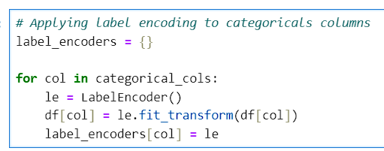
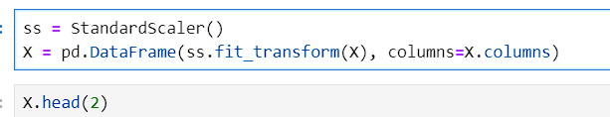
Label Encoder : Encode Categorical Columns
Applied Label Encoder to to categorical column.
Preserved relative feature relationships, optimizing data for accuracy and enabling reliable cross-metric comparisons
Standard Scaler :
The StandardScaler is a tool from the sklearn.preprocessing module that standardizes features by removing the mean and scaling them to unit variance. This ensures that the features have a mean of 0 and a standard deviation of 1, which can be particularly important when using machine learning algorithms

Slide 11
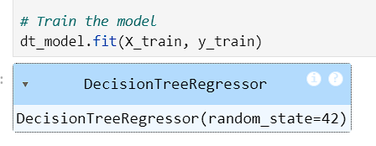
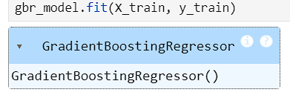
Model Building
1. Decision Tree Regressor:
The Decision Tree Regressor is a non-parametric model that splits the data into subsets based on feature values, creating a tree-like structure. Each split is determined by minimizing a criterion such as mean squared error (MSE) to best predict the target variable.
2. Gradient Boosting Regressor:
The Gradient Boosting Regressor is an ensemble learning method that builds models sequentially. It combines the predictions of multiple weak learners (typically decision trees) to create a strong predictive model.
3.XGBoost Regressor:
The XGBoost Regressor is an advanced form of gradient boosting that enhances performance and speed through various optimizations like regularization and parallel computation.

Slide 12
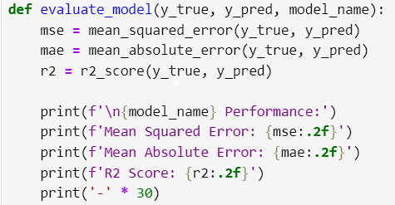
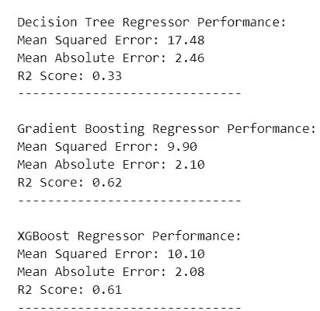
Performance Evaluation
All three models are able to predict the target variable to some extent. The R2 scores are positive, indicating that the models explain some of the variance in the target data.
Gradient Boosting Regressor and XGBoost Regressor generally outperform Decision Tree Regressor. Both Gradient Boosting and XGBoost have lower MSE and MAE values, suggesting that they make more accurate predictions on average.
Gradient Boosting Regressor achieves the highest R2 score. This indicates that it explains the most variance in the target data, suggesting it is the best model among the three in terms of overall fit.

Slide 13
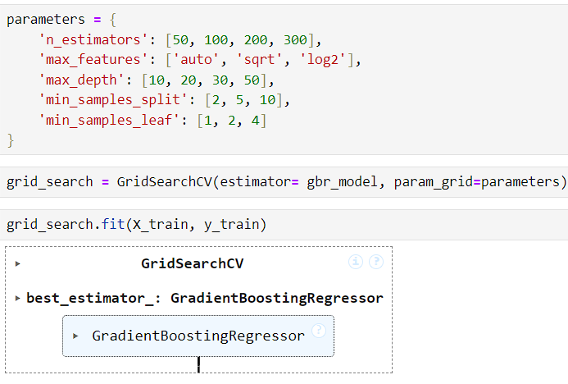

Hyperparameter Tuning
The hyperparameters being tuned include:
n_estimators: The number of boosting stages.
max_features: The number of features to consider at each split.
max_depth: The maximum depth of each tree.
min_samples_split: The minimum number of samples required to split an internal node.
min_samples_leaf: The minimum number of samples required to be at a leaf node.
MSE: A lower MSE indicates better model performance.
In this case,the MSE is relatively low, suggesting that the
model is making reasonably accurate predictions.
R-Squared: A higher R-squared indicates better model fit. In
this case, the R-squared is 0.62, which means that the model
explains about 62% of the variation in the target variable.

Slide 14
Thank You!

